Slide 1
Common Bus System
&
Computer Instructions

Slide 2
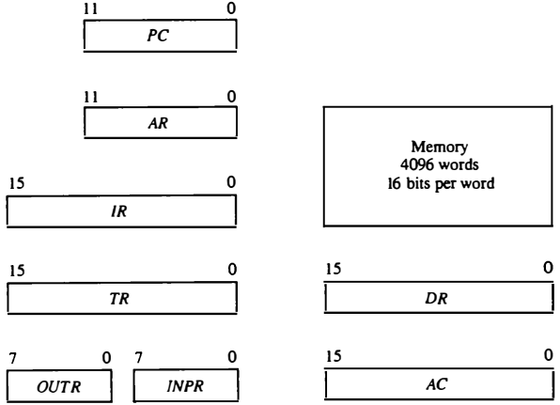
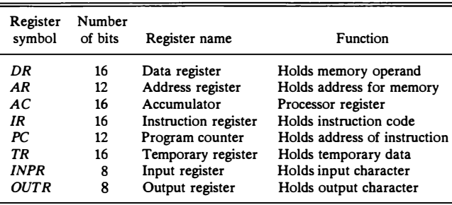
Registers for the Basic Computer

Slide 3
Common Bus System
Path must be provided to transfer information form one register to another register and between memory and registers.
The number of wires will be excessive if connections are made between the outputs of each register and the inputs of the other registers.
A more efficient scheme for transferring information in a system with many registers is to use a common bus system.

Slide 4
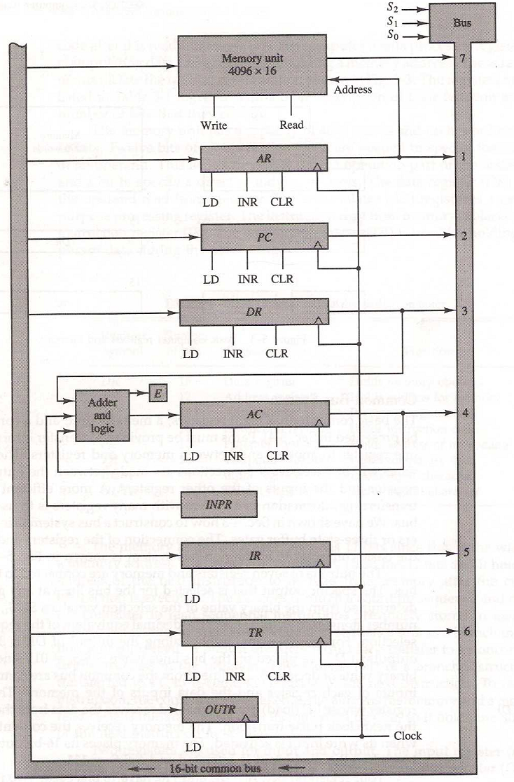
Basic computer registers connected to a common bus

Slide 5
Common Bus System
S₂S₁S₀: Selects the register/memory that would use the bus.
LD (load): When enabled, the particular register receives the data from the bus during the next clock pulse transition.
The memory receives the contents of the bus when its write input is activated.

Slide 6
Common Bus System
The memory places its 16-bit output onto the bus when the read input is activated and S₂S₁S₀=111.
DR, AC, IR, and TR have 16 bits each.
AR and PC: have 12 bits each since they hold a memory address

Slide 7
Common Bus System
When the contents of AR or PC are applied to the 16-bit common bus, the four most significant bits are set to zeros.
When AR or PC receives information from the bus, only the 12 least significant bits are transferred into the register.

Slide 8
Common Bus System
INPR and OUTR: communicate with the eight least significant bits in the bus.
INPR: Receives a character from the input device (keyboard,…etc) which is then transferred to AC.
OUTR: Receives a character from AC and delivers it to an output device (say a Monitor).

Slide 9
Common Bus System
The common bus receive information from six registers and the memory unit. The bus lines are connected to the inputs of six registers and the memory.
Five registers have three control inputs: LD (load), INR (increment), and CLR (clear). This type of register is equivalent to a binary counter with parallel load and synchronous clear.

Slide 10
Common Bus System
The increment operation is achieved by enabling the count input of the counter.
Two registers have only a LD input.

Slide 11
Common Bus System
The input data and output data of the memory are connected to the common bus.
But the memory address is connected to AR.

Slide 12
Common Bus System
Therefore, AR must always be used to specify a memory address.
By using a single register for the address, we eliminate the need for an address bus that would have been needed otherwise.

Slide 13
Common Bus System
Register → Memory: Write operation
Memory → Register: Read operation (note that AC cannot directly read from memory)
The 16-bit inputs of AC come from an adder and logic circuit. The circuit has three sets of inputs.

Slide 14
Common Bus System
One set of 16-bit inputs come from the outputs of AC.
They are used to implement register micro-operations such as complement AC and shift AC.
The inputs from DR and AC are used for arithmetic and logic micro-operations, such as add DR to AC, etc.

Slide 15
Common Bus System
The result of an addition is transferred to AC and the end carry-out of the addition is transferred to flip-flop E (extended AC bit).
The third set of 8-bit inputs come from the input register INPR.

Slide 16
Common Bus System
The content of any register can be applied onto the bus and an operation can be performed in the adder and logic circuit during the same clock cycle

Slide 17
Computer Instructions
An Instruction is a group of bits that instructs the computer to perform a specific operation.
The most basic part of an instruction is its operation code part.
The operation code of an instruction is a group of bits that defines certain operations such as add, subtract, shift, and complement.

Slide 18
Computer Instructions
The number of bits required for the operation code depends on the total number of operations available in the computer.
2^{n} (or little less) distinct operations
n bit operation code

Slide 19
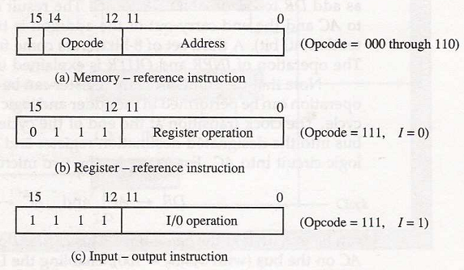
Computer Instructions
The basic computer has three instruction code formats
Each format has 16 bits.
Fig: Basic computer instruction formats

Slide 20
Computer Instructions
A memory-reference instruction uses one bit to specify the addressing mode I. I = 0 for direct, 1=Indirect
Fig: Basic computer instruction formats

Slide 21
Computer Instructions
A register-reference instruction specifies an operation on AC, other 12 bits are used to specify the operation
Fig: Basic computer instruction formats

Slide 22
Computer Instructions
An IO instruction does not need a reference to memory, remaining 12 bits are used to specify the type of IO operation
Fig: Basic computer instruction formats

Slide 23
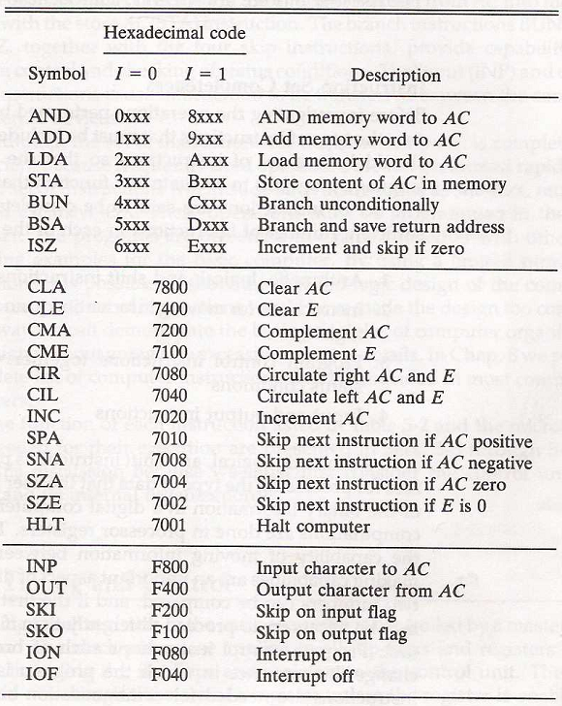
Basic computer instructions
Tab: Basic computer instructions

